Slide 1
Modulation
Review…

Slide 2
Baseband Transmission
Digital transmission is the transmission of electrical pulses. Digital information is binary in nature in that it has only two possible states 1 or 0. Sequences of bits encode data (e.g., text characters).
Digital signals are commonly referred to as baseband signals.
In order to successfully send and receive a message, both the sender and receiver have to agree how often the sender can transmit data (data rate).
Data rate often called bandwidth – but there is a different definition of bandwidth referring to the frequency range of a signal!

Slide 3
Baseband Transmission
With unipolar signaling techniques, the voltage is always positive or negative (like a dc current).
In bipolar signaling, the 1’s and 0’s vary from a plus voltage to a minus voltage (like an ac current).
In general, bipolar signaling experiences fewer errors than unipolar signaling because the signals are more distinct.

Slide 4
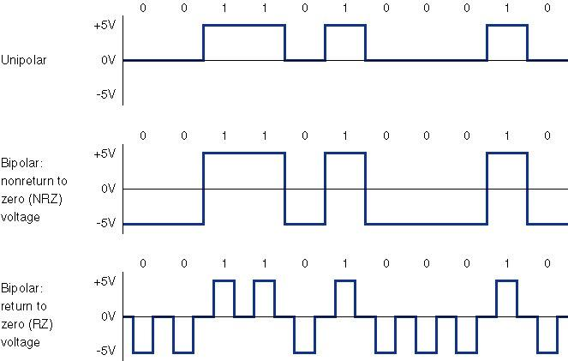
Baseband Transmission

Slide 5
Baseband Transmission
Manchester encoding is a special type of unipolar signaling in which the signal is changed from a high to low (0) or low to high (1) in the middle of the signal.
More reliable detection of transition rather than level
  consider perhaps some constant amount of dc noise, transitions still detectable but dc component could throw off NRZ-L scheme
  Transitions still detectable even if polarity reversed
Manchester encoding is commonly used in local area networks (ethernet, token ring).

Slide 6
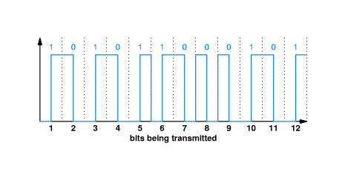
Manchester Encoding

Slide 7
ANALOG TRANSMISSION OF DIGITAL DATA
Analog Transmission occurs when the signal sent over the transmission media continuously varies from one state to another in a wave-like pattern.
e.g. telephone networks, originally built for human speech rather than data.
Advantage for long distance communications: much less attenuation for analog carrier than digital

Slide 8
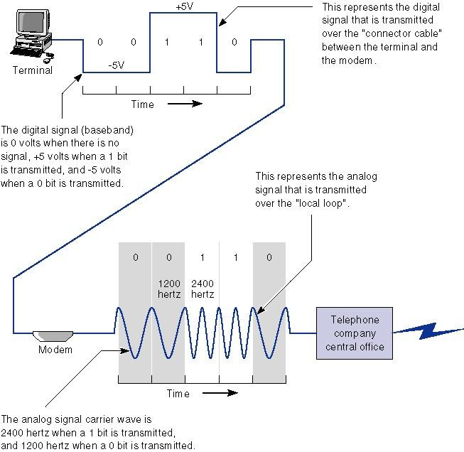

Slide 9
Digital Data to Analog Transmission
Before we get further into Analog to Digital, we need to understand various characteristics of analog transmission.

Slide 10
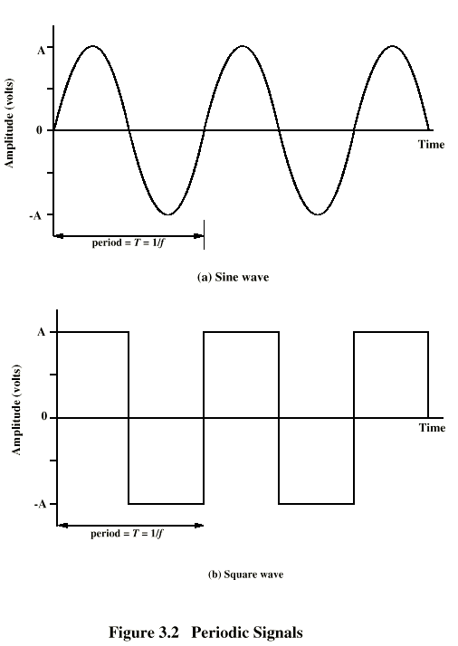
Periodic
Signals

Slide 11
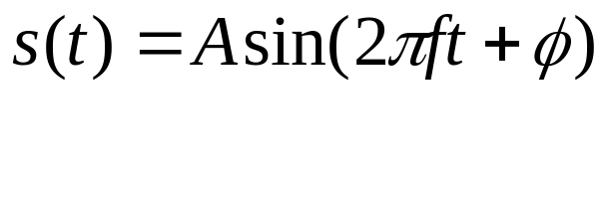
Sine Wave
Peak Amplitude (A)
  maximum strength of signal
  volts
Frequency (f)
  Rate of change of signal
  Hertz (Hz) or cycles per second
  Period = time for one repetition (T)
  T = 1/f
Phase (φ)
  Relative position in time, from 0-2*pi
General Sine wave

Slide 12
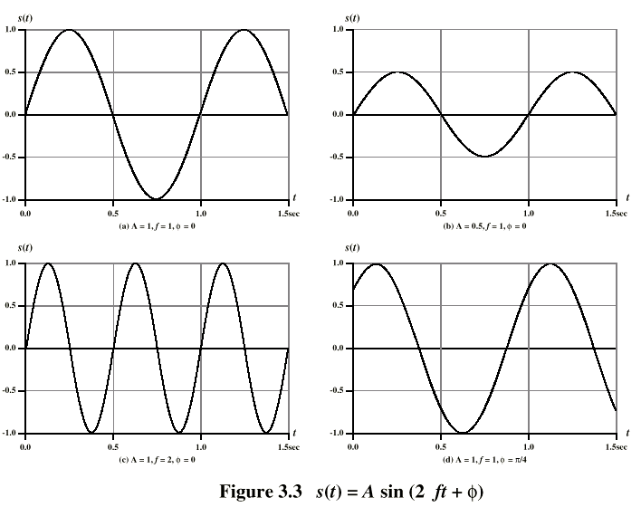
Varying Sine Waves

Slide 13
Wavelength
Distance occupied by one cycle
Distance between two points of corresponding phase in two consecutive cycles
λ = Wavelength
Assuming signal velocity v
  λ = vT
  λf = v
  c = 3*10⁸ ms⁻¹ (speed of light in free space)

Slide 14
Frequency Domain Concepts
Signal usually made up of many frequencies
Components are sine (or cosine) waves
Can be shown (Fourier analysis) that any continuous signal is made up of component sine waves
Can plot frequency domain functions

Slide 15
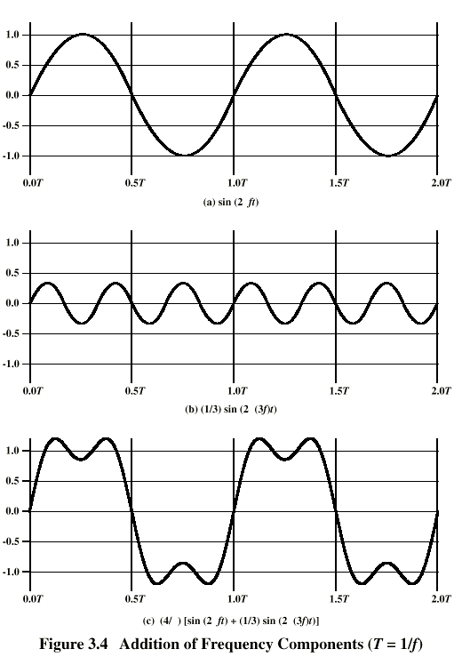
Addition of
Frequency
Components
Notes:
2nd freq a multiple of 1st
1st called fundamental freq
Others called harmonics
Period of combined =
Period of the fundamental
Fundamental = carrier freq

Slide 16
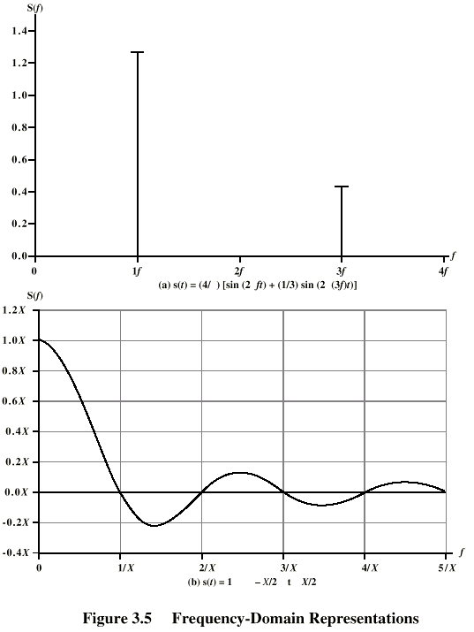
Frequency
Domain
Discrete Freq Rep:
Any continuous signal can be represented as the sum of sine waves! (May need an infinite number..)
Discrete signals result in
Continuous, Infinite Frequency Rep:
s(t)=1 from –X/2 to X/2

Slide 17
Data Rate and Bandwidth
Any transmission system has a limited band of frequencies
This limits the data rate that can be carried
Spectrum
  range of frequencies contained in signal
Absolute bandwidth
  width of spectrum
Effective bandwidth
  Often just bandwidth
  Narrow band of frequencies containing most of the energy

Slide 18
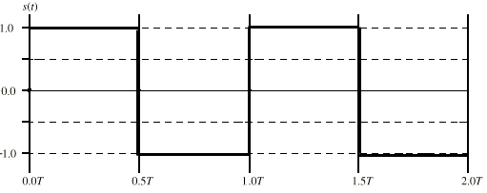
Example of Data Rate/Bandwidth
Want to transmit:
Let’s say that f=1Mhz or 10⁶ cycles/second, so T= 1microsecond
Let’s approximate the square wave with a few sine waves:

Slide 19
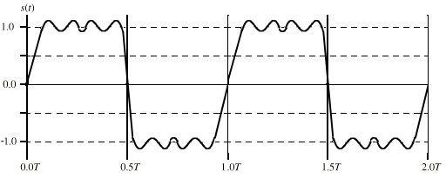
Ex(1): Sine Wave 1
Bandwidth=5f-f =4f
If f=1Mhz, then the bandwidth = 4Mhz
T=1 microsecond; we can send two bits per microsecond so
the data rate = 2 * 10⁶ = 2Mbps

Slide 20
Ex(2): Sine Wave 1, Higher freq
Bandwidth=5f-f =4f
If f=2Mhz, then the bandwidth = 8Mhz
T=0.5 microsecond; we can send two bits per 0.5 microseconds
or 4 bits per microsecond, so the data rate = 4 * 10⁶ = 4Mbps
Double the bandwidth, double the data rate!

Slide 21
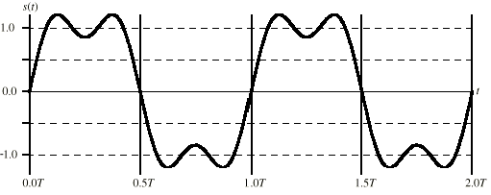
Ex(3): Sine Wave 2
Bandwidth=3f-f =2f
If f=2Mhz, then the bandwidth = 4Mhz
T=0.5 microsecond; we can send two bits per 0.5 microseconds
or 4 bits per microsecond, so the data rate = 4 * 10⁶ = 4Mbps
Still possible to get 4Mbps with the “lower” bandwidth, but our receiver must be able to discriminate from more distortion!

Slide 22
Multiplexers
A multiplexer puts two or more simultaneous transmissions on a single communications circuit.
Generally speaking, the multiplexed circuit must have the same capacity as the sum of the circuits it combines.
The primary benefit of multiplexing is to save money.

Slide 23
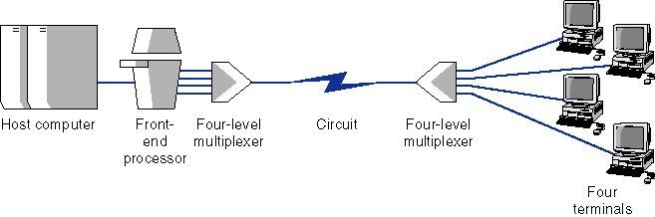
Multiplexed Circuit

Slide 24
Multiplexing
There are three major types of multiplexers
Frequency division multiplexers (FDM)
  E.g. AM/FM Radio, Telephone
Time division multiplexers (TDM)
  ISDN
Statistical time division multiplexers (STDM)
  We’ll cover later (maybe)
Wavelength division multiplexing (WDM)
  Used in optical carriers (colors carry signals)

Slide 25
Frequency Division Multiplexing (FDM)
Frequency division multiplexers can be described as dividing the circuit “horizontally” so that many signals can travel a single communication circuit simultaneously.
The circuit is divided into a series of separate channels, each transmitting on a different frequency.
Guardbands are employed to keep one channel from leaking over into another channel.
Frequency division multiplexers are somewhat inflexible because once you determine how many channels are required, it may be difficult to add more channels without purchasing an entirely new multiplexer.

Slide 26
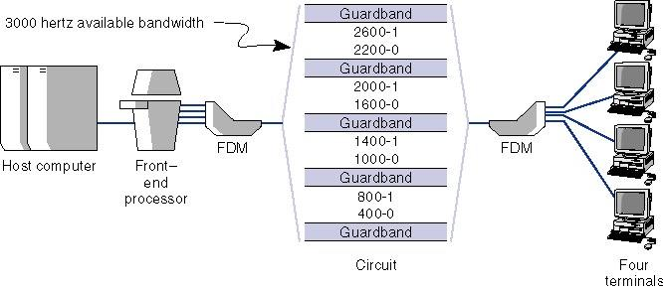
Frequency Division Multiplexing (FDM)

Slide 27
Time Division Multiplexing (TDM)
Time division multiplexing shares a circuit among two or more terminals by having them take turns, dividing the circuit “vertically.”
Time on the circuit is allocated even when data are not transmitted, so that some capacity is wasted when a terminal is idle.
Time division multiplexing is generally more efficient and less expensive to maintain than frequency division multiplexing, because it does not need guardbands.

Slide 28
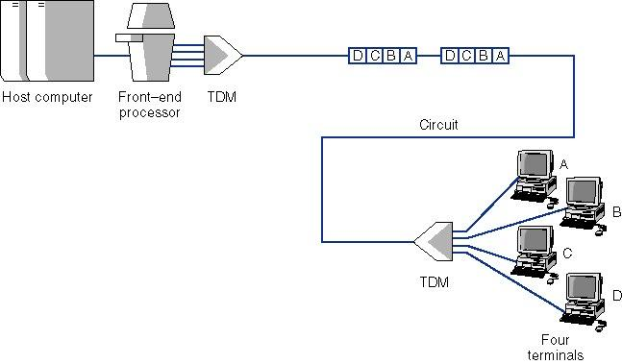
Time Division Multiplexing (TDM)

Slide 29
Transmission Impairments
Signal received may differ from signal transmitted
Analog - degradation of signal quality
Digital - bit errors
Caused by
  Attenuation and attenuation distortion
  Delay distortion
  Noise

Slide 30
Attenuation
Signal strength falls off with distance
Depends on medium
Received signal strength:
  must be enough to be detected
  must be sufficiently higher than noise to be received without error
Attenuation is an increasing function of frequency; higher frequencies suffer from more attenuation. Can distort the signal.
Solution: Equalization. Boost higher frequency components.

Slide 31
Delay Distortion
Only in guided media
Propagation velocity varies with frequency
  Velocity highest near center frequency
  Results in phase shift at different frequencies
  “Overlapping” bits
Solution: Equalization

Slide 32
Noise (1)
Additional signals inserted between transmitter and receiver
Thermal
  Due to thermal agitation of electrons
  Uniformly distributed
  White noise
Intermodulation
  Signals that are the sum and difference of original frequencies sharing a medium

Slide 33
Noise (2)
Crosstalk
  A signal from one line is picked up by another
Impulse
  Irregular pulses or spikes
  e.g. External electromagnetic interference
  Short duration
  High amplitude

Slide 34
What Causes Errors?
Summary of Errors and Noise:
Source of Error What Causes It How to Prevent It.
Line Outages
White Noise
Impulse Noise
Cross-Talk
Echo
Attenuation
Intermodulation
Noise
Jitter
Harmonic Distortion
Storms, Accidents
Movement of electrons
Sudden increases in electricity
(e.g. lightning)
Multiplexer guardbands too small,
or wires too close together
Poor connections
Graduate decrease in signal
over distance
Signals from several circuits combine
Analog signals change phase
Amplifier changes phase
Increase signal strength
Shield or move the wires
Increase the guardbands, or
move or shield the wires
Fix the connections, or
tune equipment
Use repeaters or amps
Move or shield the wires
Tune equipment
Tune equipment

Slide 35
Error Prevention
There are many ways to prevent errors:
Shielding (adding insulation)
Moving cables away from noise sources
Changing multiplexing type (FDM→TDM)
Tuning transmission equipment and improving connection quality
Using amplifiers and repeaters
Equalization
Leasing conditioned circuits

Slide 36
Modulation - Digital Data, Analog Signal
Public telephone system
  300Hz to 3400Hz
    Guardband from 0-300, 3400-4000Hz
  Use modem (modulator-demodulator)
Amplitude shift keying (ASK)
Frequency shift keying (FSK)
Phase shift keying (PSK)

Slide 37
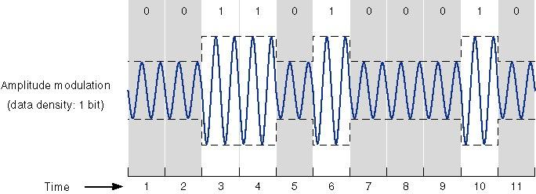
Amplitude Modulation and ASK

Slide 38
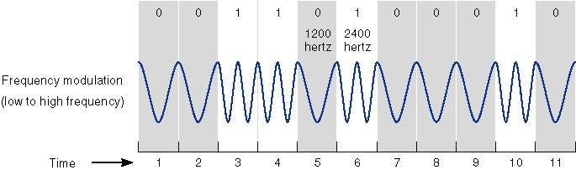
Frequency Modulation and FSK

Slide 39
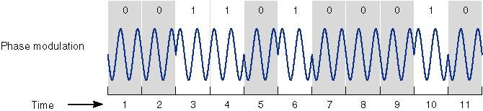
Phase Modulation and PSK

Slide 40
Amplitude Shift Keying
Values represented by different amplitudes of carrier
Usually, one amplitude is zero
  i.e. presence and absence of carrier is used
Susceptible to sudden gain changes
Inefficient
Typically used up to 1200bps on voice grade lines
Used over optical fiber

Slide 41
Frequency Shift Keying
Values represented by different frequencies (near carrier)
Less susceptible to error than ASK
Typically used up to 1200bps on voice grade lines
High frequency radio
Even higher frequency on LANs using co-ax

Slide 42
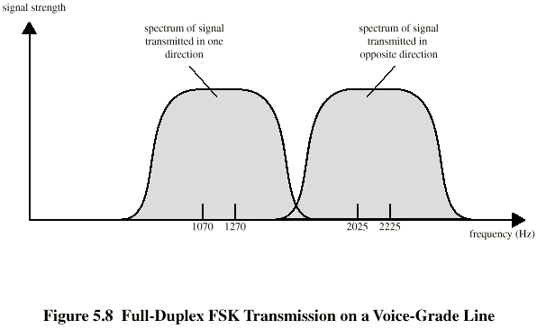
FSK on Voice Grade Line
Bell Systems 108 modem

Slide 43
Phase Shift Keying
Phase of carrier signal is shifted to represent data
Differential PSK
  Phase shifted relative to previous transmission rather than some reference signal

Slide 44
Sending Multiple Bits Simultaneously
Each of the three modulation techniques can be refined to send more than one bit at a time. It is possible to send two bits on one wave by defining four different amplitudes.
This technique could be further refined to send three bits at the same time by defining 8 different amplitude levels or four bits by defining 16, etc. The same approach can be used for frequency and phase modulation.

Slide 45
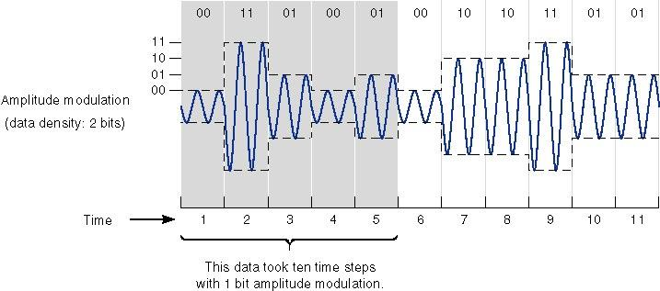
Sending Multiple Bits Simultaneously

Slide 46
Sending Multiple Bits Simultaneously
In practice, the maximum number of bits that can be sent with any one of these techniques is about five bits. The solution is to combine modulation techniques.
One popular technique is quadrature amplitude modulation (QAM) involves splitting the signal into eight different phases, and two different amplitude for a total of 16 different possible values, giving us lg(16) or 4 bits per value.

Slide 47
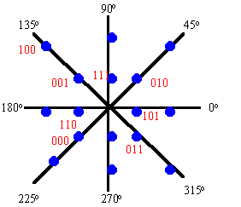
2-D Diagram of QAM

Slide 48
Sending Multiple Bits Simultaneously
Trellis coded modulation (TCM) is an enhancement of QAM that combines phase modulation and amplitude modulation.
The problem with high speed modulation techniques such as TCM is that they are more sensitive to imperfections in the communications circuit.

Slide 49
Bits Rate Versus Baud Rate Versus Symbol Rate
The terms bit rate (the number of bits per second) and baud rate are used incorrectly much of the time. They are not the same.
A bit is a unit of information, a baud is a unit of signaling speed, the number of times a signal on a communications circuit changes. ITU-T now recommends the term baud rate be replaced by the term symbol rate.

Slide 50
Bits Rate Versus Baud Rate Versus Symbol Rate
The bit rate and the symbol rate (or baud rate) are the same only when one bit is sent on each symbol. If we use QAM or TCM, the bit rate would be several times the baud rate.

Slide 51
Modem Standards
There are many different types of modems available today.
Most modems support several standards so that they can communicate with a variety of different modems.
Better modems can change data rates during transmission to reduce the rate in case of noisy transmission (fast retrain).

Slide 52
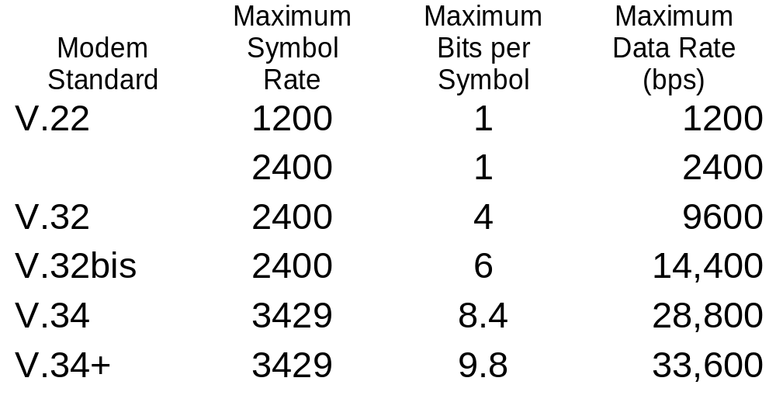
Modem Standards

Slide 53
Modem Standards
V.22
  1200-2400 baud/bps, FSK
V.32 and V.32bis
  full duplex at 9600 bps (2400 baud at QAM)
  bis uses TCM to achieve 14,400 bps.
V.34 and V.34bis
  Works best for phone networks using digital transmission beyond the local loop to reduce noise. Up to 28,800 bps (TCM)
  bis up to 36,600 with TCM

Slide 54
Modem Standards
V.42bis
  data compression modems, accomplished by run length encoding, code book compression, Huffman encoding and adaptive Huffman encoding
  MNP5 - uses Huffman encoding to attain 1.3:1 to 2:1 compression.
  bis uses Lempel-Ziv encoding and attains 3.5:1 to 4:1.
  V.42bis compression can be added to almost any modem standard effectively tripling the data rate.

Slide 55
Analog Data, Digital Signal
Digitization
  Conversion of analog data into digital data
  Digital data can then be transmitted using digital signaling (e.g. Manchester)
  Or, digital data can then be converted to analog signal
  Analog to digital conversion done using a codec (coder/decoder)
  Two techniques to convert analog to digital
    Pulse code modulation / Pulse amplitude modulation
    Delta modulation

Slide 56
Pulse Amplitude Modulation
Analog voice data must be translated into a series of binary digits before they can be transmitted.
With Pulse Amplitude Modulation, the amplitude of the sound wave is sampled at regular intervals and translated into a binary number.
The difference between the original analog signal and the translated digital signal is called quantizing error.

Slide 57
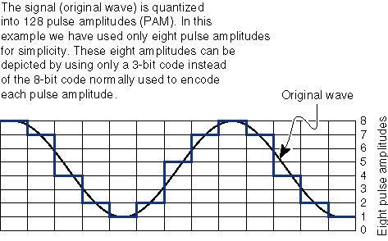
Pulse Amplitude Modulation

Slide 58
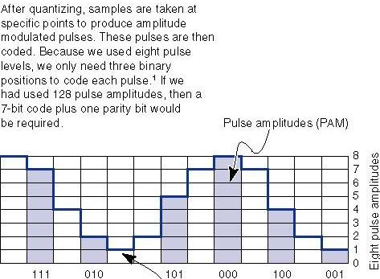
Pulse Amplitude Modulation

Slide 59
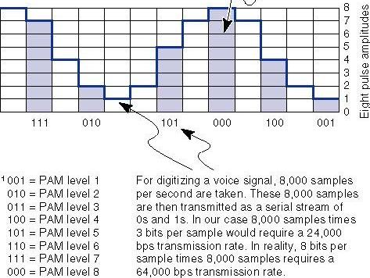
Pulse Amplitude Modulation

Slide 60
Pulse Amplitude Modulation
For standard voice grade circuits, the sampling of 3300 Hz at an average of 2 samples/second would result in a sample rate of 6600 times per second.
There are two ways to reduce quantizing error and improve the quality of the PAM signal.
  Increase the number of amplitude levels
  Sample more frequently (oversampling).

Slide 61
Pulse Code Modulation
Pulse Code Modulation is the most commonly used technique in the PAM family and uses a sampling rate of 8000 samples per second.
Each sample is an 8 bit sample resulting in a digital rate of 64,000 bps (8 x 8000).
Sampling Theorem: If a signal is sampled at a rate higher than twice the highest signal frequency, then the samples contain all the information of the original signal.
E.g.: For voice capped at 4Khz, can sample at 8000 times per second to regenerate the original signal.

Slide 62
Analog Data, Analog Signals
Why modulate analog signals?
  Higher frequency can give more efficient transmission
  Permits frequency division multiplexing
Types of modulation
  Amplitude
  Frequency
  Phase
Ex. Of analog/analog modulation : Spread Spectrum

Slide 63
Spread Spectrum
Analog or digital data
Analog signal
Spread data over wide bandwidth
Makes jamming and interception harder
Frequency hopping
  Signal broadcast over pseudorandom series of frequencies
Direct Sequence
  Each bit is represented by multiple bits in transmitted signal
  Chipping code

